Slide 1




North Shore .NET User Group
Our Sponsors

Slide 2
Hacking on Azure Websites
with Node.js and the Spotify Web API
@DanielLarsenNZ

Slide 3
This talk
Node.js on Azure Websites
Spotify Web API
Node.js + Express
WebJobs, Queue Storage

Slide 4
JavaScript on the Server?
I !♥ JS

Slide 5
I !♥ JS
Not to love | Node.js
Interpreted in real time. | V8 compiles JS into native machine code before executing.
Synchronous scripting language. | Asynchronous through callback pattern.
Performance issues in Browsers. | Single Threaded Event Loop pattern enables scale to tens of thousands of connections.
Dynamic Type system. | It’s still there and makes sense for many applications. TypeScript can help if you need Static Types.

Slide 6
JavaScript on the Server!
I ♥ JS
Great for:
APIs
Bounded Context
Polyglot programming
Mixed Linux / Windows environments
SOA & Microservices
Scale!

Slide 7

Azure Websites
Node.js
Express
Sails.js
Waterline
MongoDB
Angularjs
Ionic
Mobile Angular
PureCSS

Slide 8
Node.js on Azure Websites
Azure Website Instance
IIS
iisnode
Node.exe (V8)
JS
Packages
Notes:
Node.js is a platform, or a runtime environment.

Slide 9

Node.js in Visual Studio
Node Tools for Visual Studio (NTVS) 1.0
Visual Studio 2015 Preview
(NTVS VS 2015 Preview Dev Build)
Visual Studio 2013 Update 4
All editions including Express Web
Visual Studio 2012 Update 4
Pro edition +

Slide 10
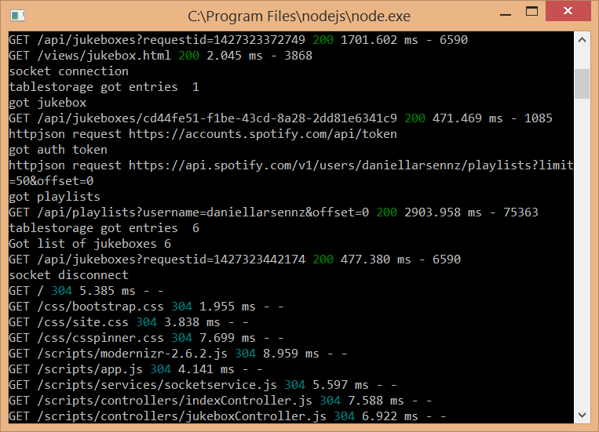
Express
Fast, un-opinionated, minimalist web framework for Node.js

Slide 11

NPM (Node.js Package Manager)
Nuget for Node.js

Slide 12
Demo
Node.js + Express + NTVS

Slide 13
Spotify Web API
https://developer.spotify.com

Slide 14
Demos
https://developer.spotify.com/web-api/
http://music.xbox.com/Developer
http://lab.possan.se/thirtify

Slide 15
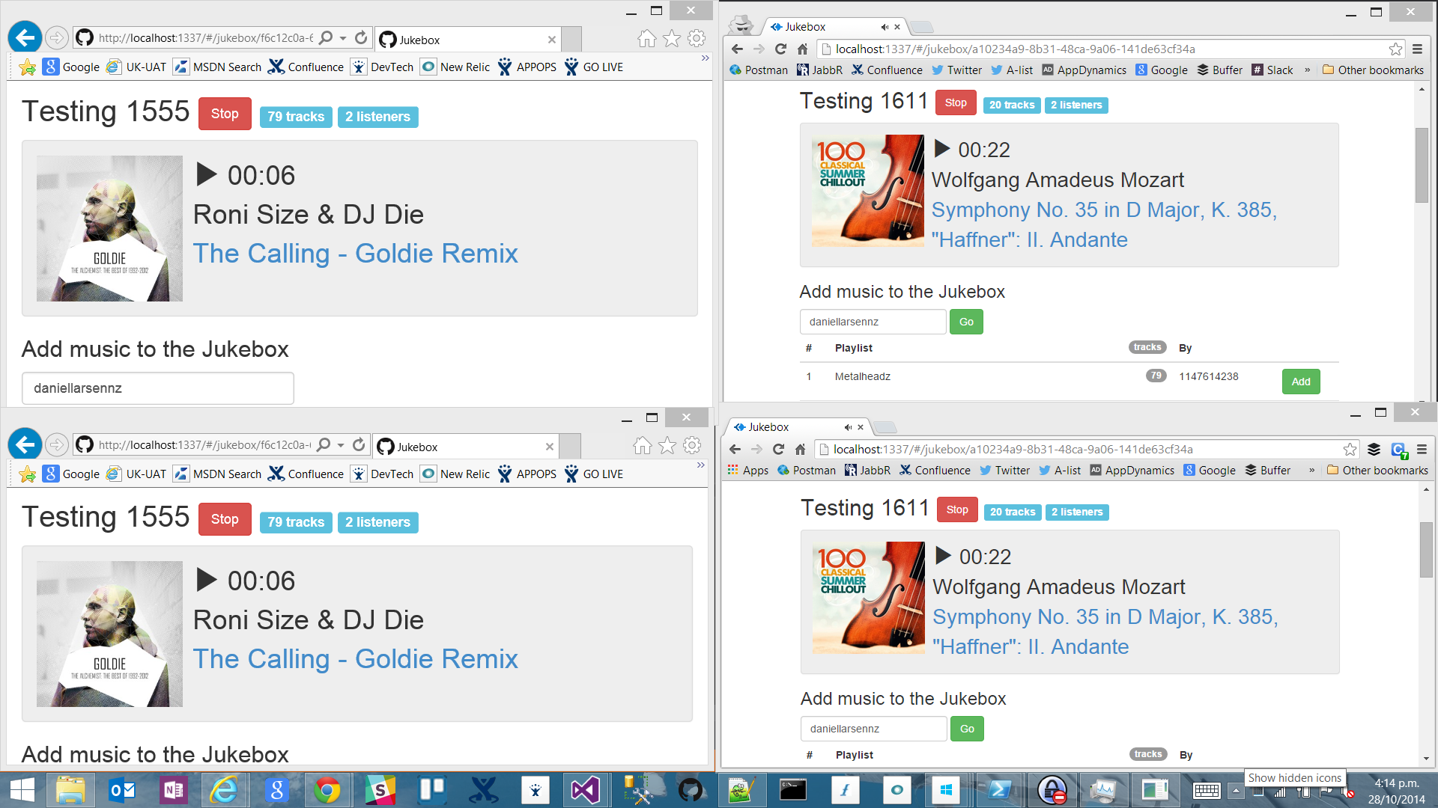
http://jukebox30.azurewebsites.net

Slide 16
Architecture
Browser
Azure Website
Azure Storage
Bootstrap
Queue Storage
Angular.js
express
socket.io
socket.io
Table Storage
Node.js
iisnode
WebJobs
Spotify Web API

Slide 17
Queue pattern
API
Message Queue
Quick Response
Node.js + express
Enqueue
Queue Storage
Dequeue
Table Storage
WebJob
C# EXE
Spotify API

Slide 18
Azure WebJobs, Queue Storage
Walkthrough

Slide 19
Recapping
Node.js on Azure Websites
Spotify Web API
Node.js + Express
WebJobs, Queue Storage

Slide 20
Questions?
Daniel Larsen
@DanielLarsenNZ
https://github.com/DanielLarsenNZ/Hacking-on-Azure

Slide 21
North Shore .NET User Group
Check out our web site
http://northshore.netusergroup.org.nz/
Follow us on Twitter
https://twitter.com/NSDNUG
Next Meeting
http://northshore.netusergroup.org.nz/Meeting/Meetup/?id=M20150423

Slide 22
Azure Queue Storage, WebJobs

Slide 23
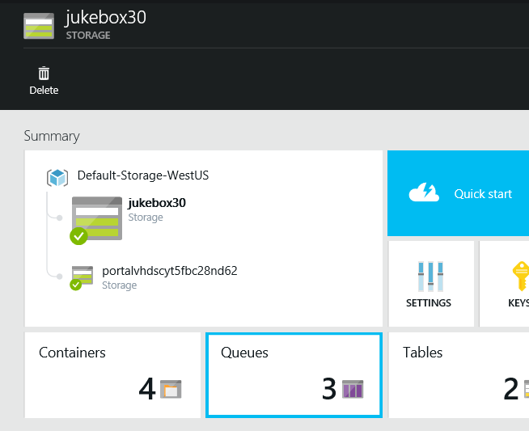
Azure Queue Storage
Simple, affordable Message Queue with geo-redundancy that massively scales.
Notes:
Simple REST API. Libraries for Node.js, .NET...
String message up to 64KB. Practically unlimited Queue size
Geo/Zone/Local redundancy. Cheap
Consider Azure ServiceBus if you need Instant Notification, Guaranteed Delivery, FIFO, etc.

Slide 24
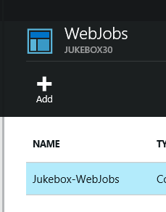
WebJobs SDK
Simple cron / AT / “Scheduled Task” style jobs that are perfect for background processing Storage operations.
Notes:
Simple jobs that can run continuously or to a schedule. Jobs can be EXEs, .JS and more.
Can run in same Azure Website as App or in a standalone Azure Website.
WebJobs SDK is a .NET library that simplifies Queue polling, poison message handling, Blob updates, etc.

Slide 25
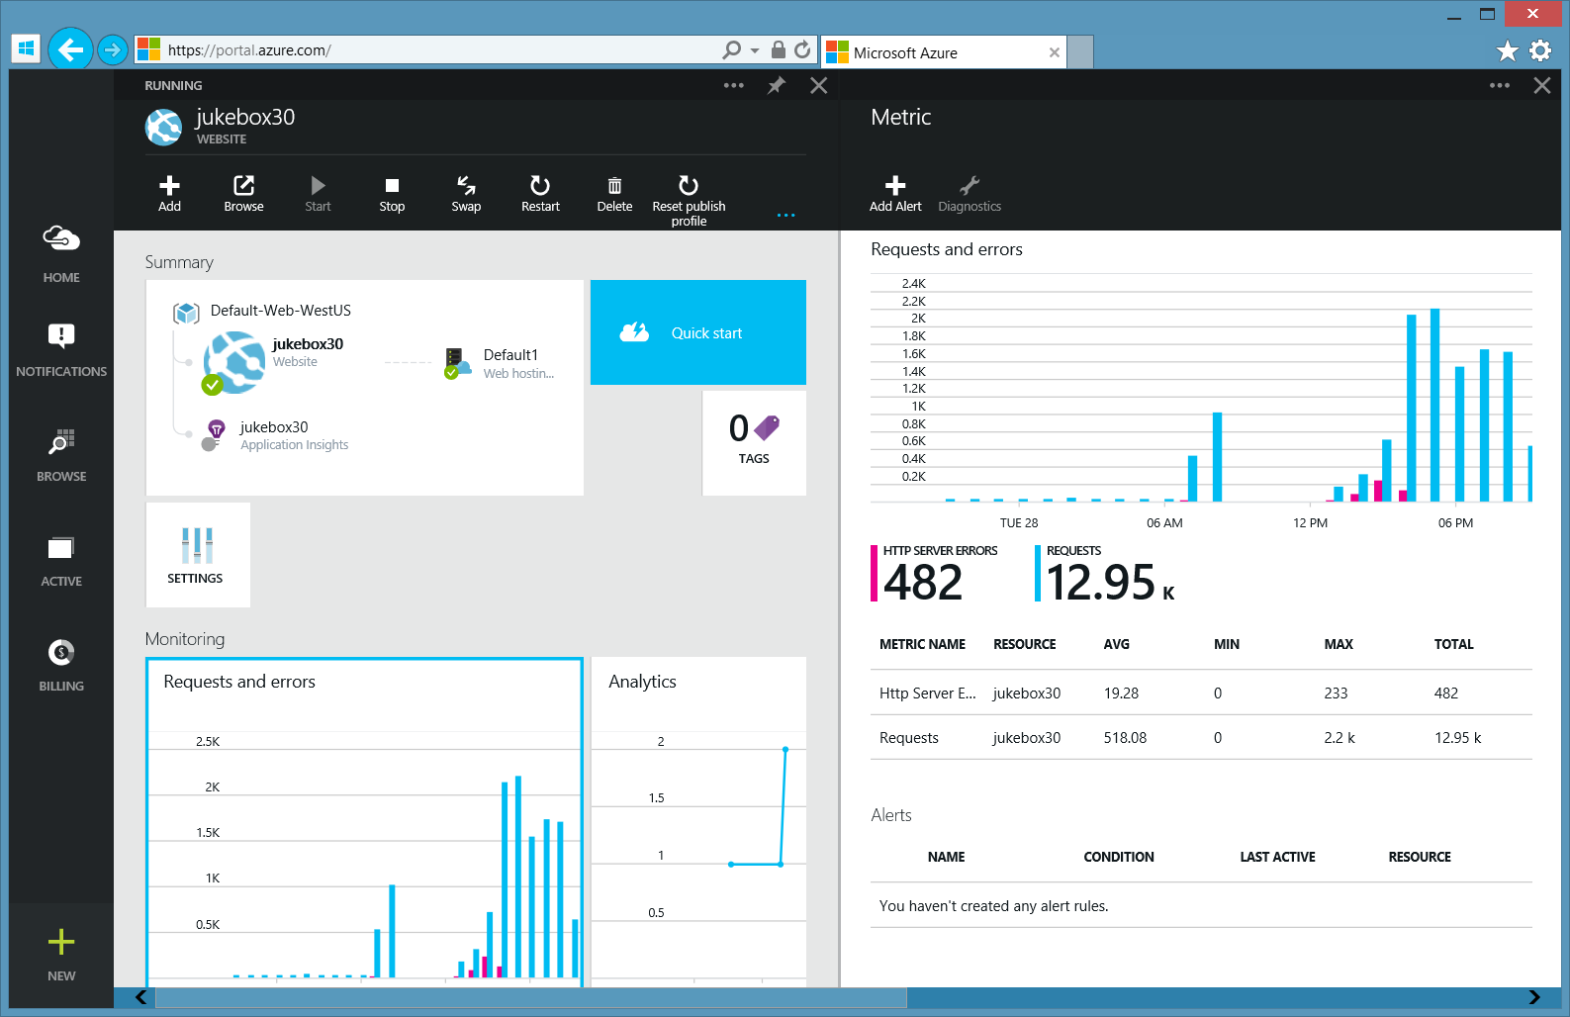
(The new) Azure Portal
Streaming logs
Monaco
…

Slide 26
Invoking C# code from Node.js with Edge.js

Slide 27
Sync pattern
UI Request waits… 1,300ms
API
Spotify API
Node.js
Table Storage
C# DLL

Slide 28
Inception
Azure Website Instance
IIS
iisnode
Node.exe
JavaScript
Edge.js
C#
Notes:
Node.js is a platform, or a runtime environment.

Slide 29
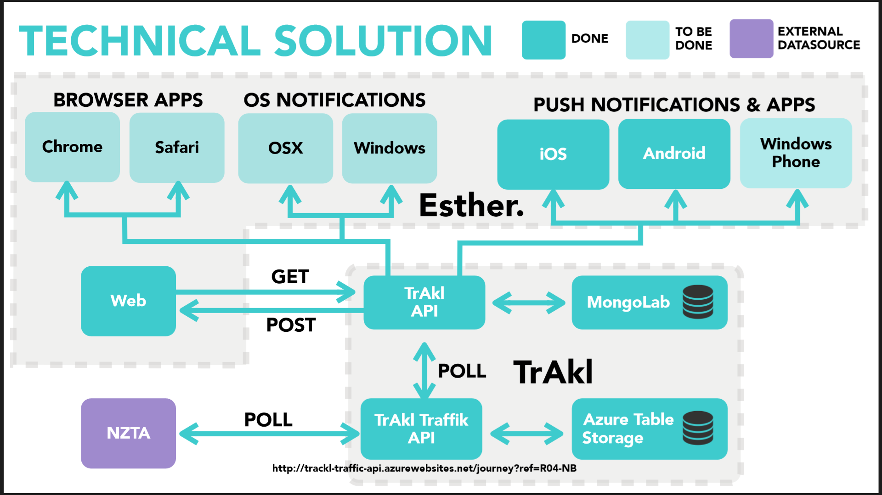

Slide 30


http://hackakl.org.nz/
Notes:
Hacking is: “The act of engaging in programming in a spirit of playfulness and exploration.
Hacker is: “A person who enjoys exploring the details of programmable systems and stretching their capabilities.
“Hacking entails some form of excellence, for example exploring the limits of what is possible, thereby doing something exciting and meaningful.

Slide 31
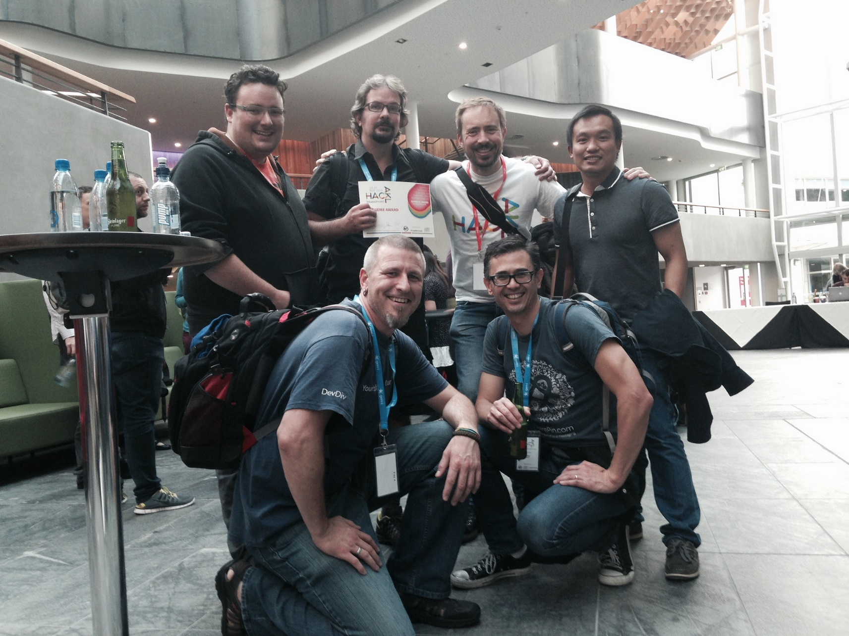

Slide 32
This talk
Node.js on Azure Websites
Spotify Web API
Node.js + Express, Table Storage
WebJobs, Queue Storage

Slide 33
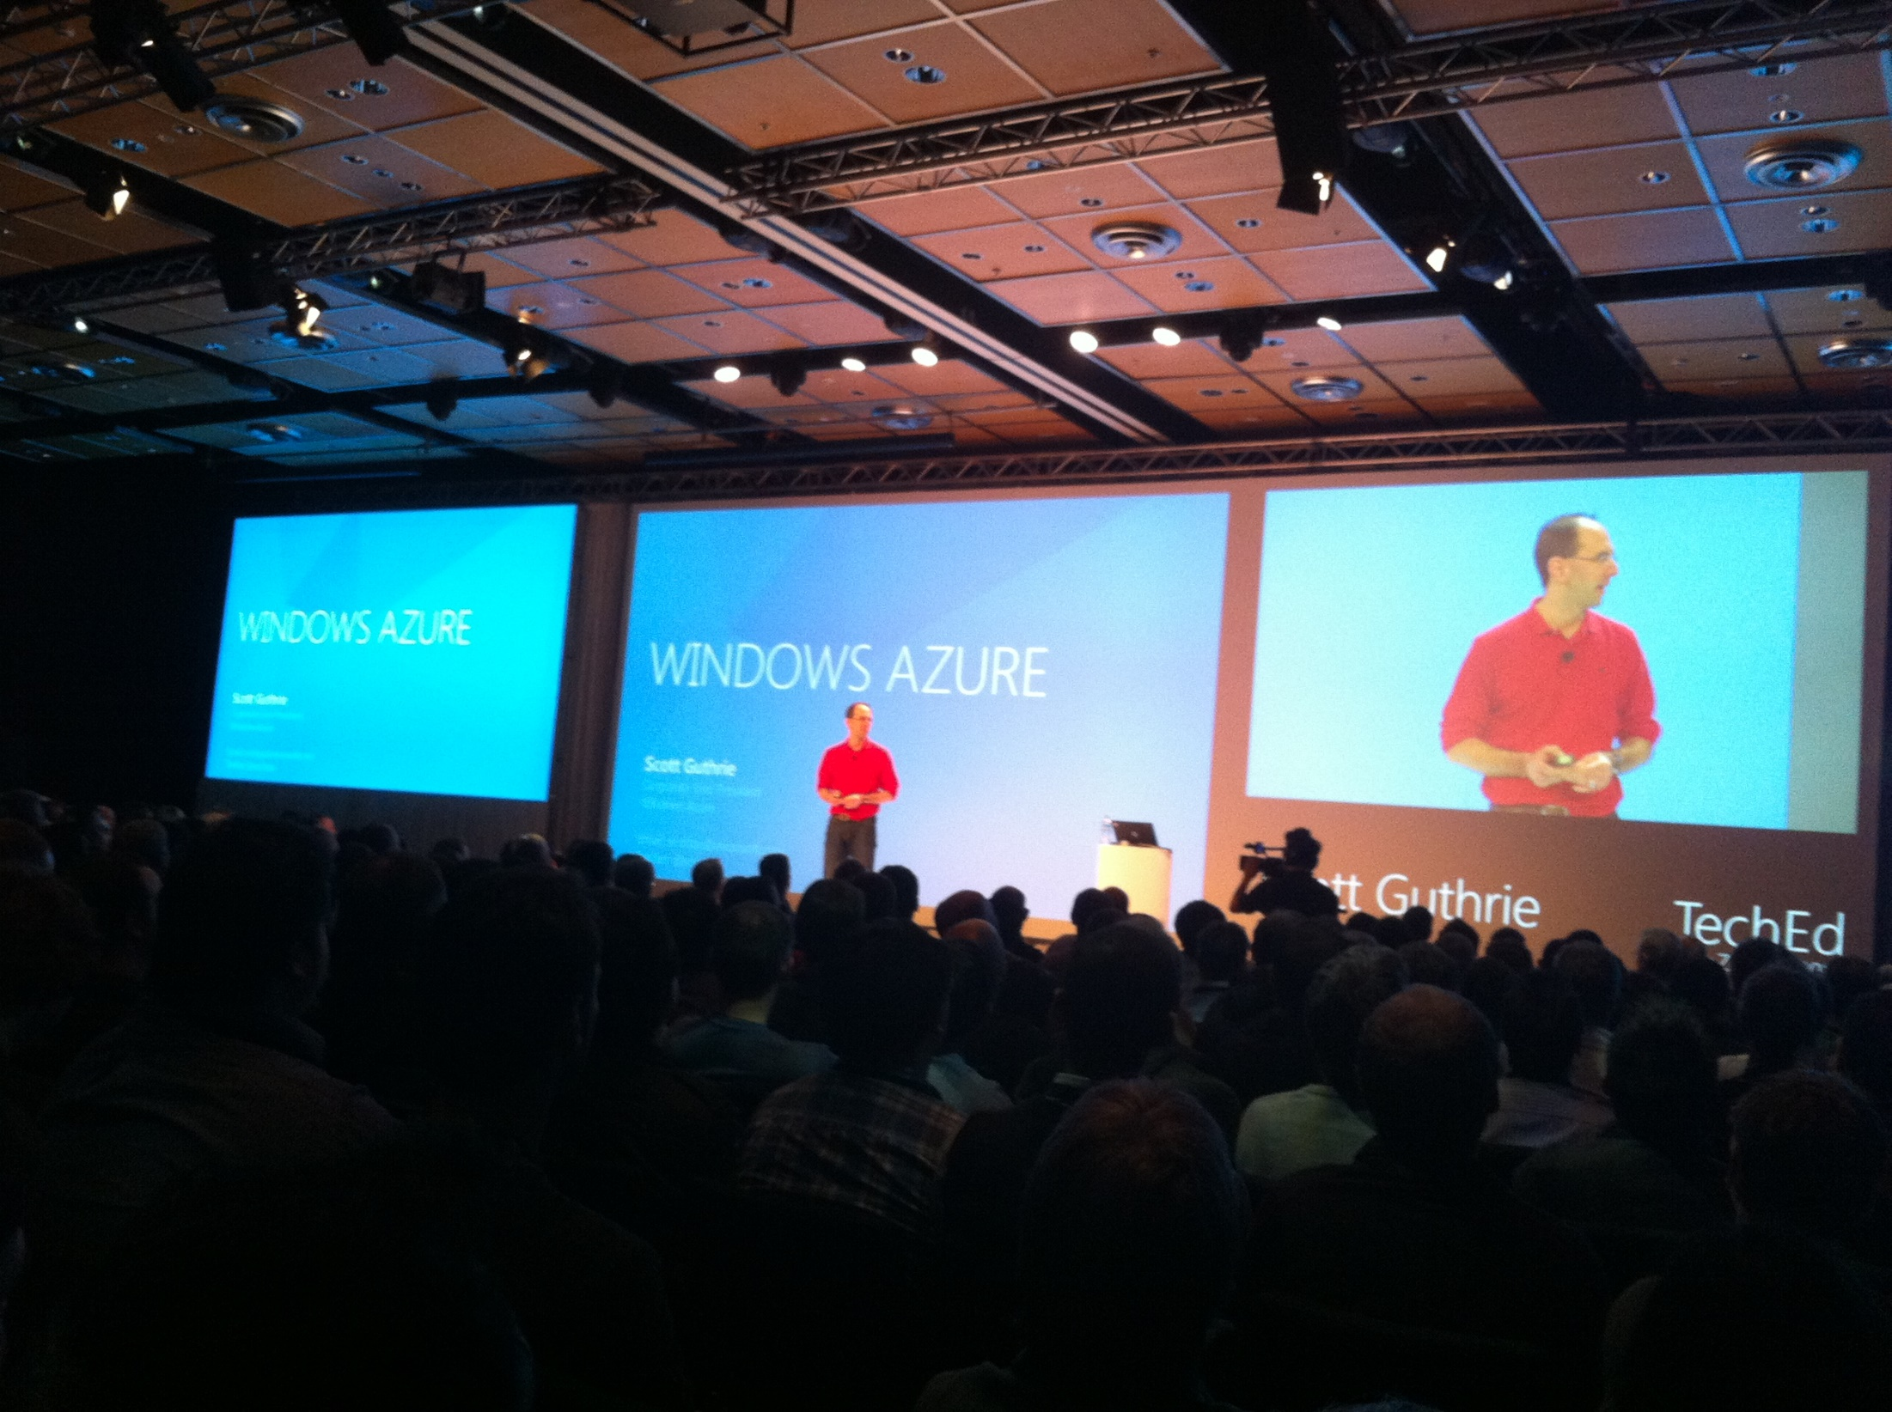

Slide 34
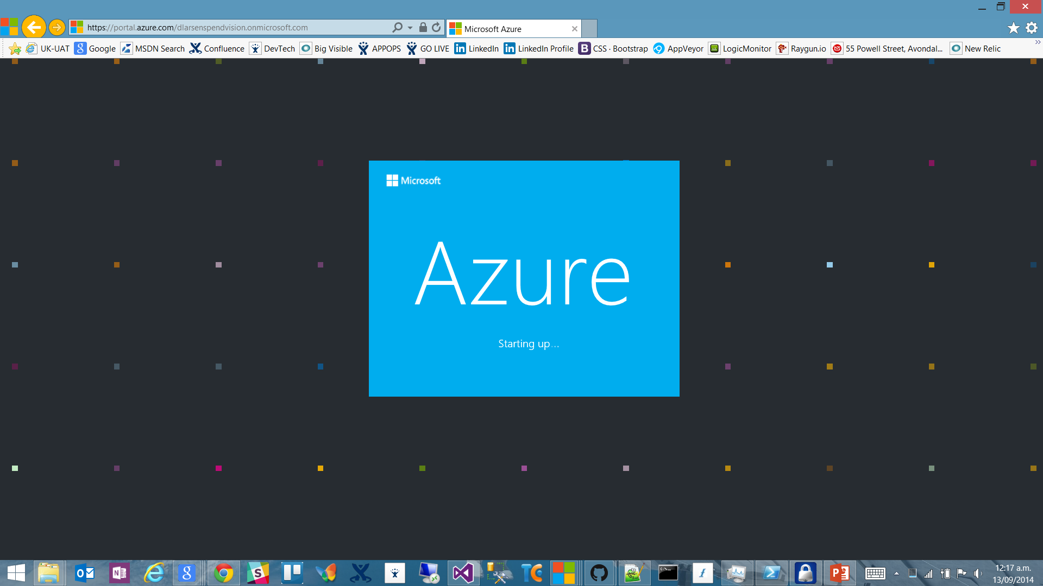

Slide 35
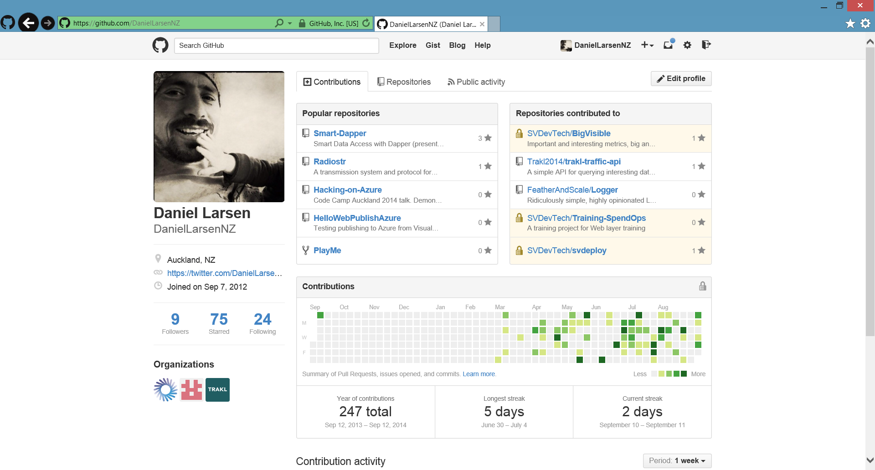

Slide 36
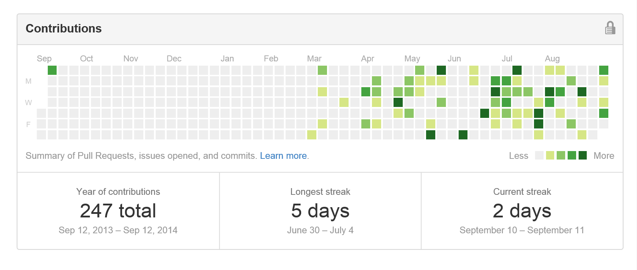
Contribution addiction

Slide 37
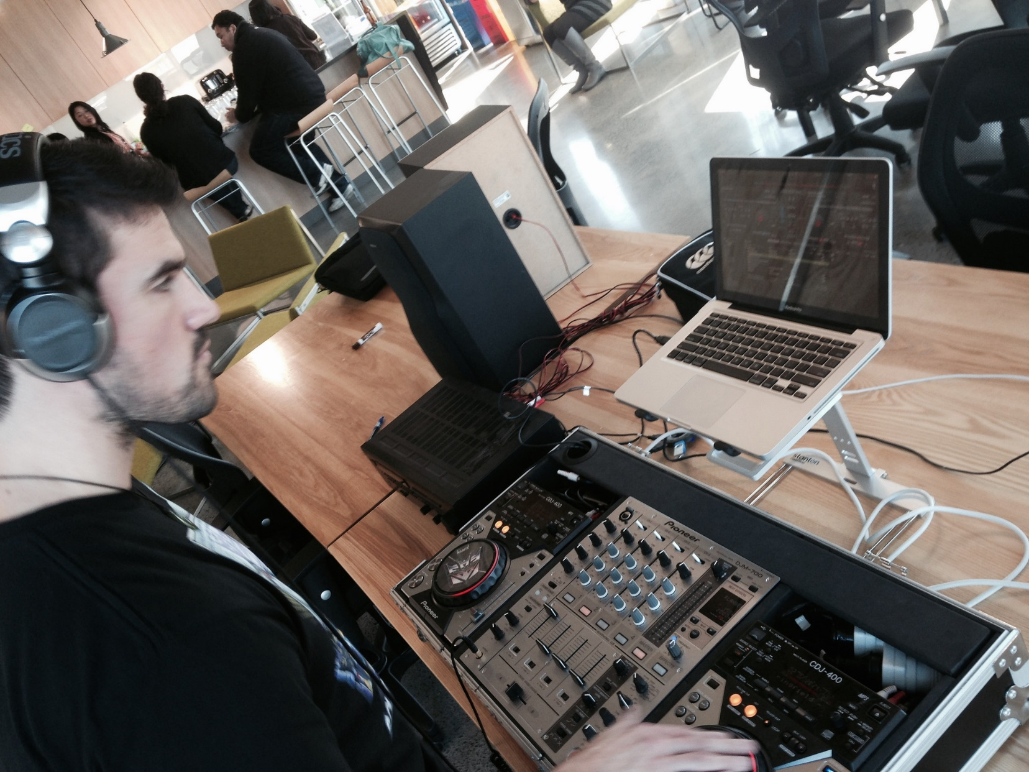

Slide 38

http://en.memory-alpha.org/wiki/Phoenix

Slide 39

By NASA [Public domain], via Wikimedia Commons http://commons.wikimedia.org/wiki/File%3AApollo_11_Earth.jpg

Slide 40
Hacking
(This is not a Security talk)

Slide 41
Hacking is exploration
“The act of engaging in programming in a spirit of playfulness and exploration.
http://en.wikipedia.org/wiki/Hacker_(programmer_subculture)

Slide 42
Hacker enjoys exploring
“A person who enjoys exploring the details of programmable systems and stretching their capabilities.
http://en.wikipedia.org/wiki/Hacker_(programmer_subculture)

Slide 43
What is possible?
“Hacking entails some form of excellence, for example exploring the limits of what is possible, thereby doing something exciting and meaningful.
http://en.wikipedia.org/wiki/Hacker_(programmer_subculture)

Slide 44
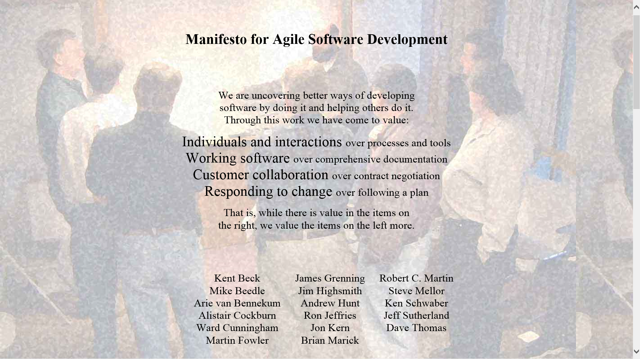

Slide 45
Architecture phase 1
Browser client (Angular.js)
Azure Website
(Node.js)
Spotify Web API
Queue Storage

Slide 46
What I didn’t talk about
New Relic
Newman
GitHub deploy
Kudu
Edge.js
CoreCLR, OWIN, Density
Azure costs
Visual Studio Monaco
Lean

Slide 48


Slide 49
http://en.memory-alpha.org/wiki/Phoenix

Slide 50
By NASA [Public domain], via Wikimedia Commons http://commons.wikimedia.org/wiki/File%3AApollo_11_Earth.jpg

